Slide 1
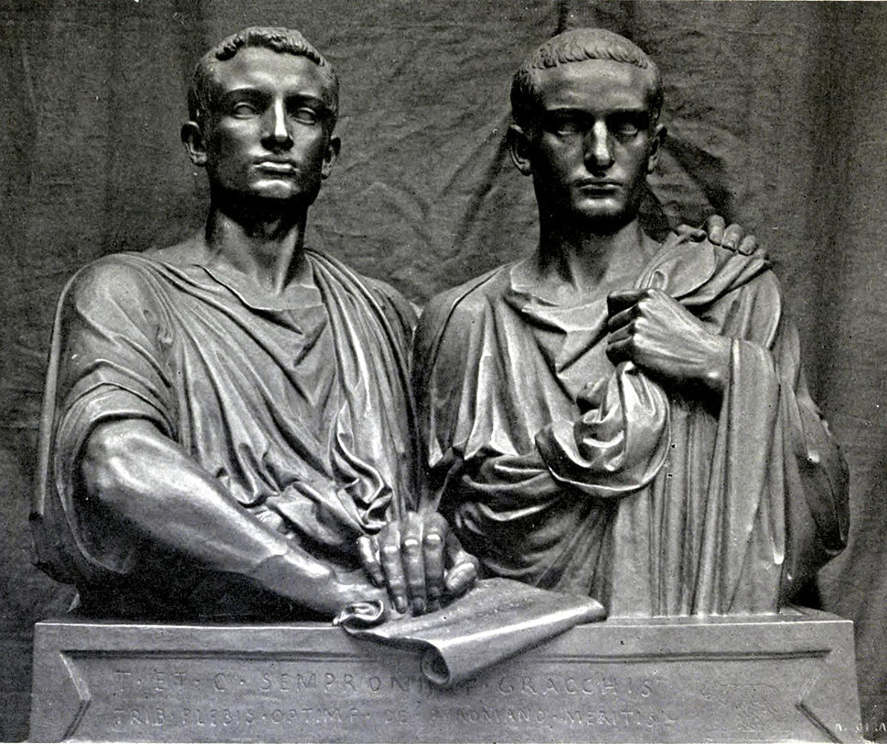
Gaius Gracchus
GOAL/S: Describe the life of Gaius Gracchus
Explain his reforms
Week 4, Lesson 3

Slide 2
Class Discussion
What do we already know about the Gracchi/Tiberius?

Slide 3
Watch the following
https://www.youtube.com/watch?v=WpL7xwCBM34&ab_channel=ExtraHistory

Slide 4
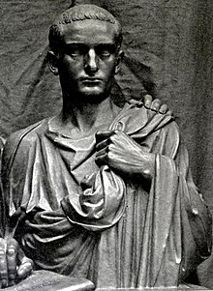
Gaius Sempronius Gracchus
Born: c. 154 BCE
Died: 121 BCE
Father: Tiberius Gracchus the elder
Mother: Cornelia Africana
He is most famous for his tribunate for the years 123 and 122 BCE, in which he proposed a wide set of laws, including laws to establish colonies outside of Italy, engage in further land reform, reform the judicial system and system for provincial assignments, and create a subsidised grain supply for Rome.

Slide 5
Political Career
Entered politics following the footsteps of his brother - Tiberius Gracchus
Served as a quaestor in 126 BCE
Served as aedile in 123 BCE
gained popularity for his efficient administration and public works
122 BCE - elected as one of the ten tribunes of the plebs
a central to his efforts in championing reforms and addressing societal issues

Slide 6
Motivations for Reforms
Economic Inequality
Large estates, owned by the wealthy elite, had expanded through land consolidation, leaving a significant portion of the Roman population landless and impoverished.
Gaius sought to address this disparity by introducing measures to redistribute land among the landless citizens, continuing the reformist agenda initiated by his brother.
SUMMARISED:

Slide 7
Motivations for Reforms
Social Unrest and Unemployment
The economic disparities contributed to social unrest, with a growing population of landless citizens facing unemployment and poverty.
Gaius recognized the link between social stability and economic well-being, motivating him to propose reforms aimed at alleviating the plight of the urban and rural poor.
SUMMARISED:

Slide 8
Motivations for Reforms
Extension of Roman Citizenship
Gaius Gracchus also sought to address the issue of citizenship.
He proposed extending Roman citizenship to some of Rome's Italian allies who had been contributing to the Roman military and economy.
This was both a measure of fairness and an attempt to secure broader support for his political agenda.
SUMMARISED:

Slide 9
Motivations for Reforms
Populist support and political legacy
Gaius Gracchus aligned himself with the Populares faction, continuing the populist approach of his brother.
His motivations were driven by a genuine concern for the well-being of the common people and a desire to curb the influence of the Senate, which was often dominated by the Optimates, the conservative aristocratic faction.
SUMMARISED:

Slide 10
Motivations for Reforms
Continuing Tiberius Gracchus’ legacy
Gaius Gracchus was deeply influenced by his brother's fate.
Tiberius Gracchus' tragic end and the failure to fully implement the land reforms fueled Gaius' determination to continue the struggle for the rights of the common people.
His motivations were shaped by a sense of duty to his family, a commitment to social justice, and a desire to leave a lasting legacy in Roman politics.
SUMMARISED:

Slide 11
Gaius Gracchus' motivations for reform were rooted in addressing economic inequality, social unrest, and the desire to continue the legacy of his family in advocating for the rights of the common people. His political career was characterised by a commitment to populist ideals and a persistent effort to challenge the entrenched power structures of the Roman Republic.

Slide 12
Actions of GG
Introducing legislation aiming to address various issues but he proposed and passed laws without Senate approval, empowering the office and challenging the authority of the Senate.
Gaius enacted measures to further distribute public land to the landless poor
Notable reform: extension of Roman citizenship to some of Rome's Italian allies which sought to integrate more people into Roman society and strengthen his position
Economic measures to address unemployment and poverty (e.g. colonies for landless citizens, providing opportunities for employment and economic stability)
Proposed laws to regulate the distribution of subsidized grain to the Roman citizens- addressing social issues and improving the welfare of the common people.

Slide 13

Senatus Consultum Ultimum
DEFINITION:
"ultimate decree of the Senate,"
extraordinary measure taken by the Roman Senate in times of perceived emergency or crisis
It granted the consuls (or other magistrates) exceptional powers to protect the state, even if it meant bypassing normal legal procedures.

Slide 14

ACTIVITY – The SCU/Comparison
Read the information sheet as a class
Answer the 3 questions in your book
Draw a FULL PAGE venn diagram
Using the information in the table provided, compare and contrast the Gracchi

